Slide 1
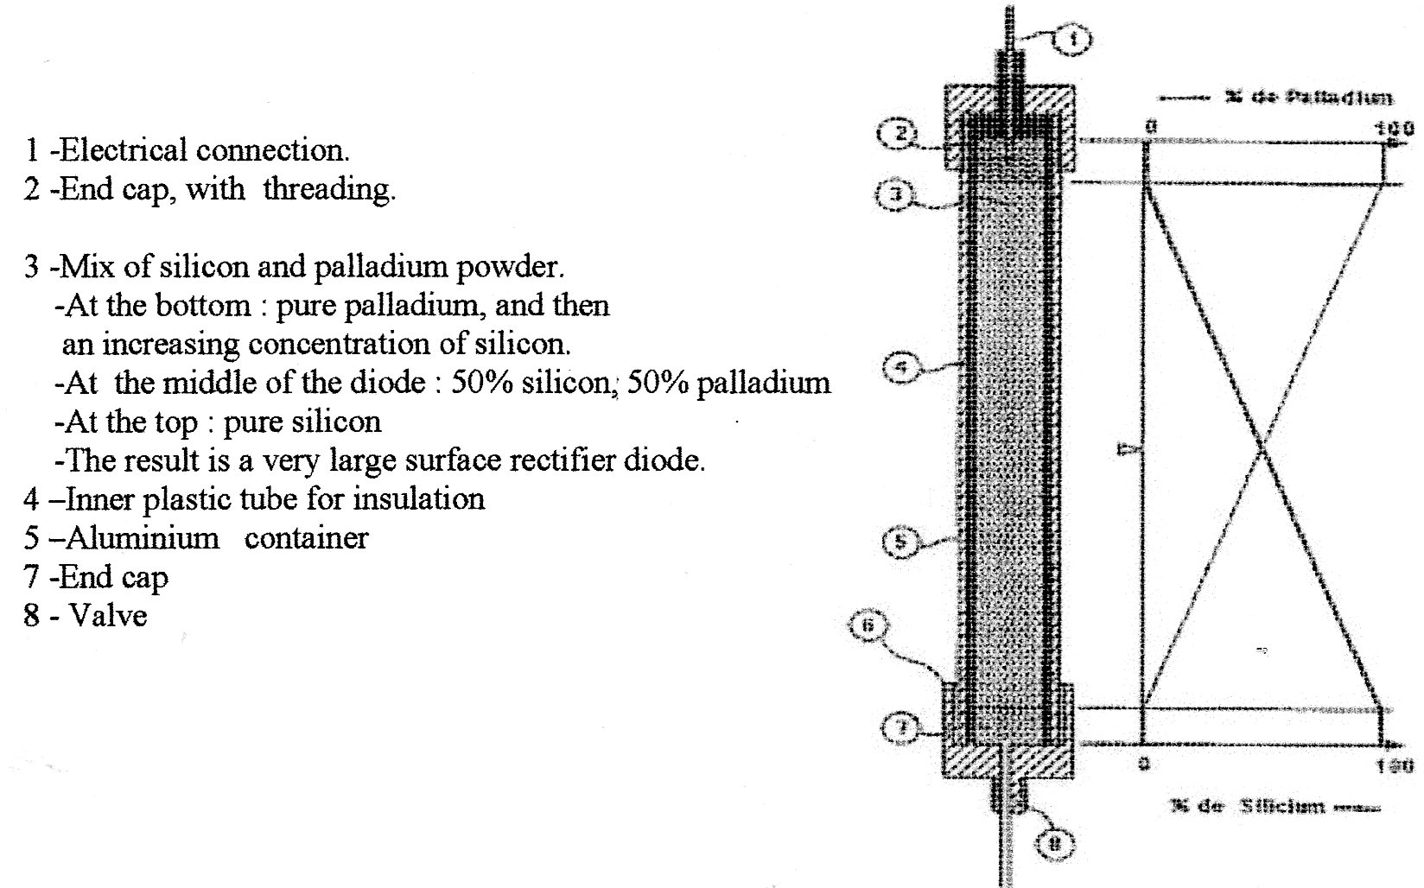
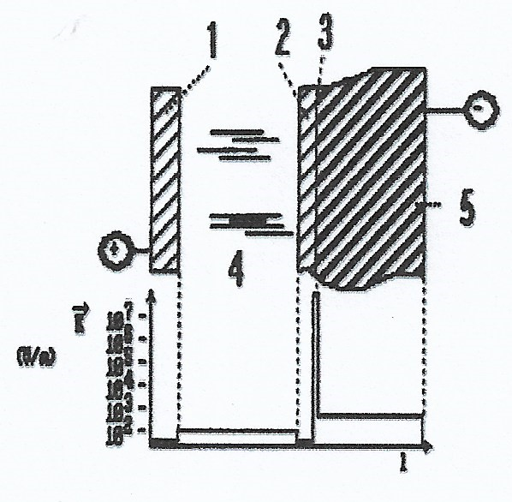
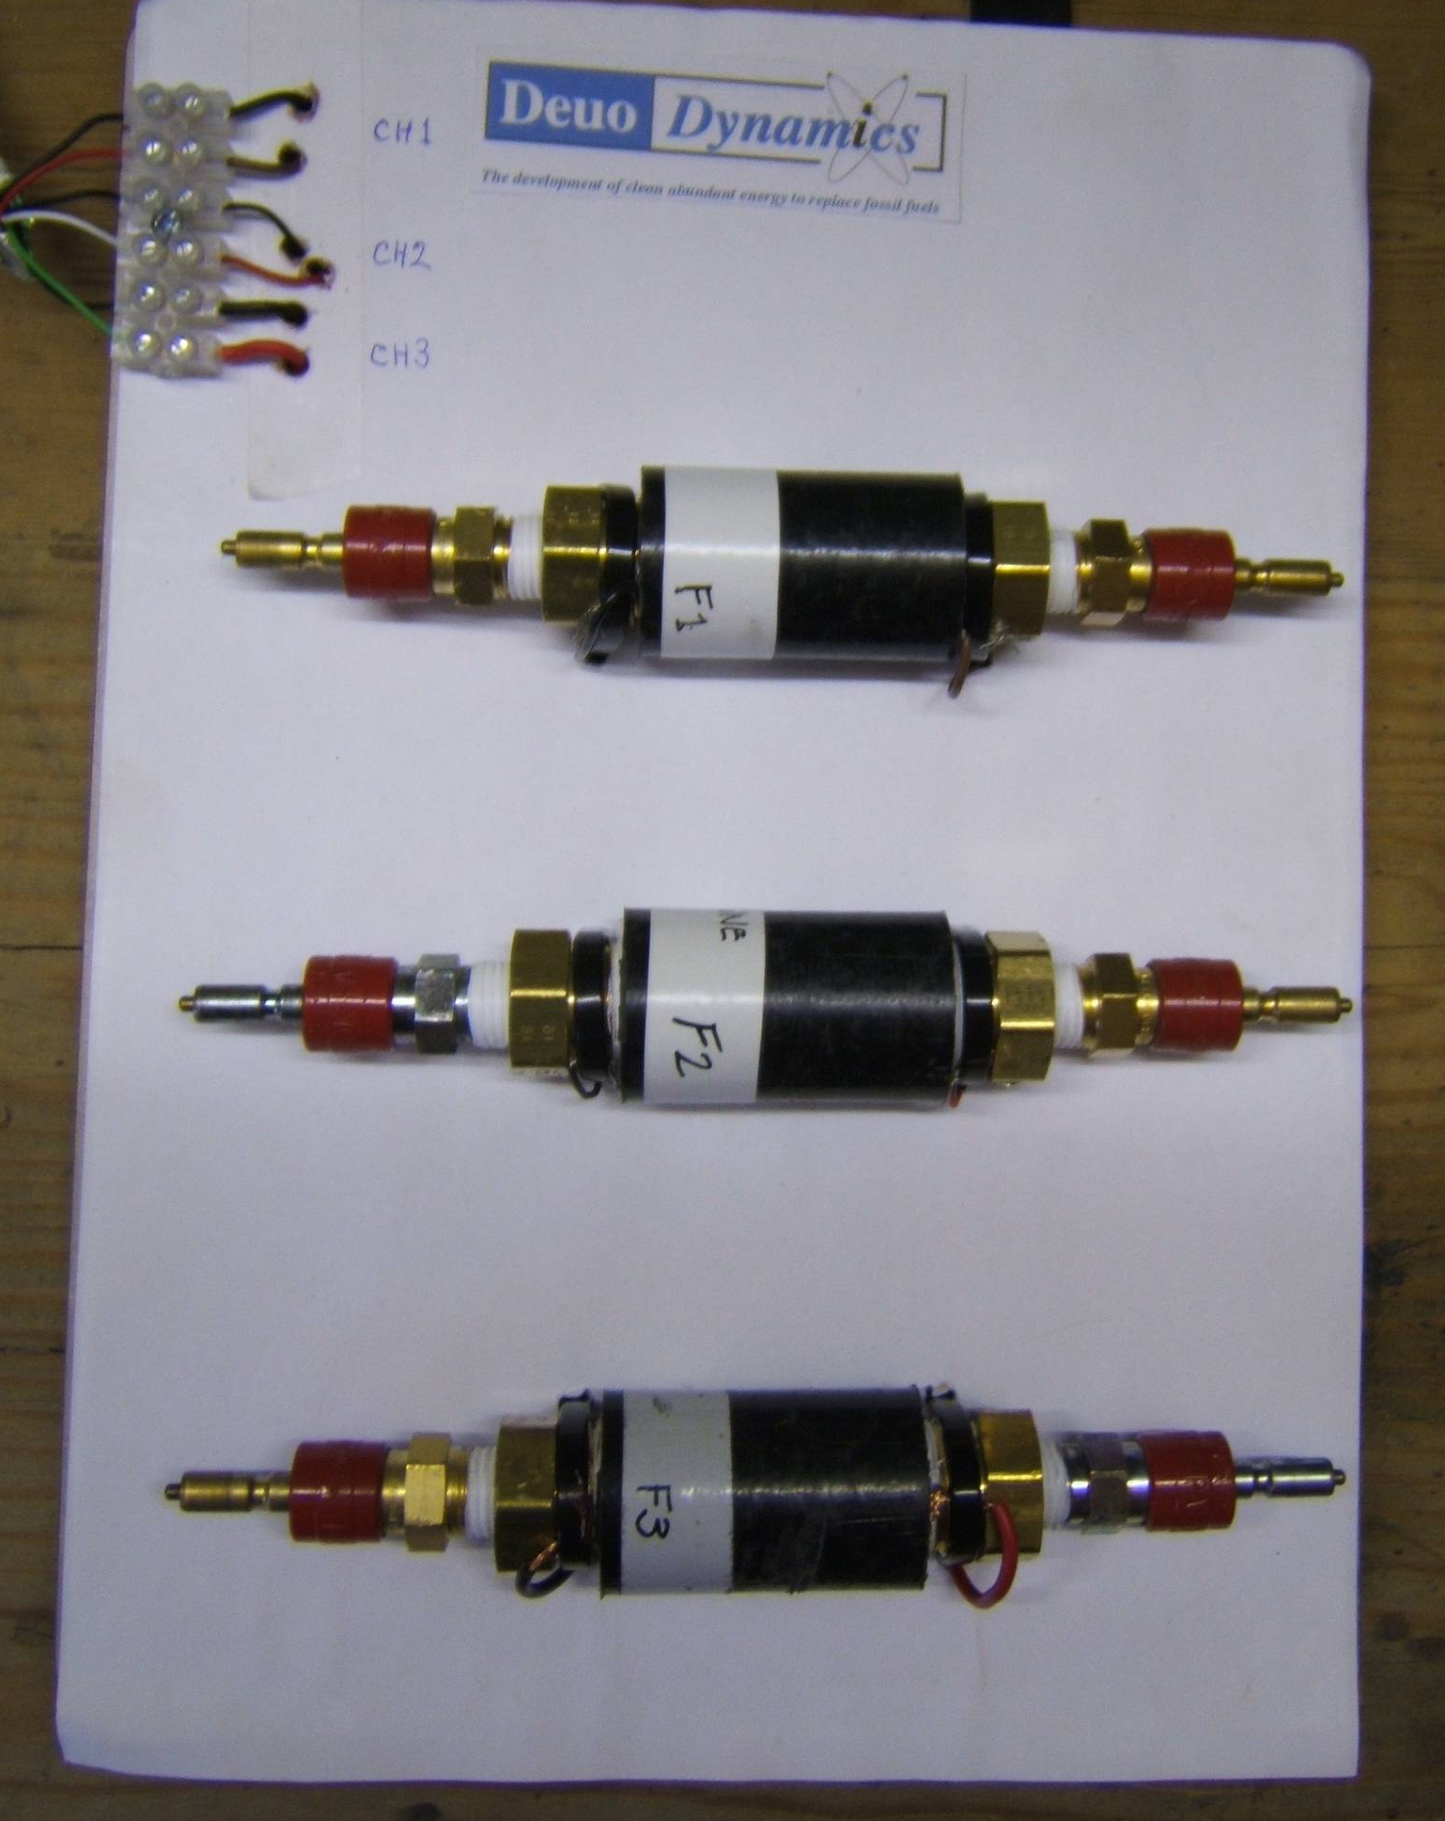
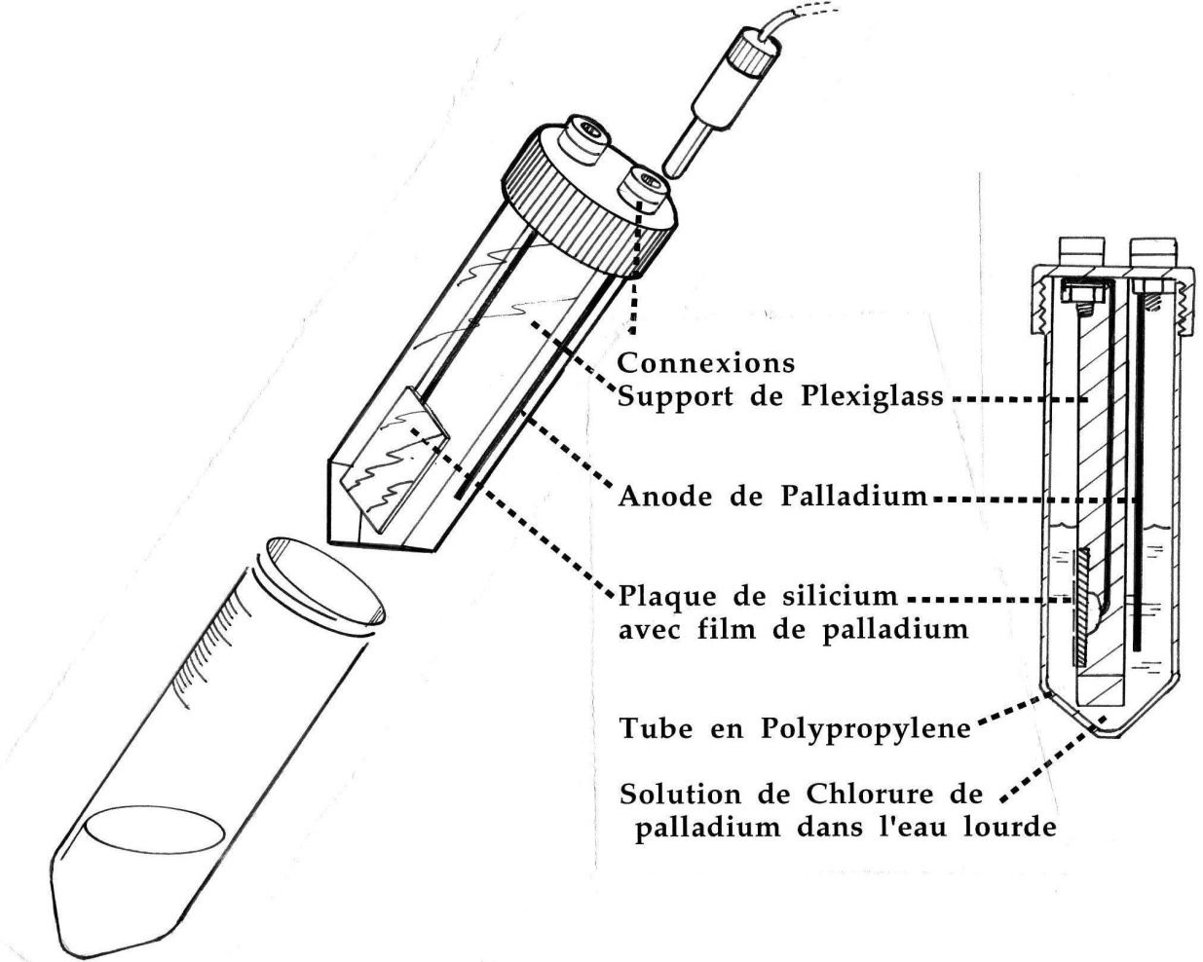
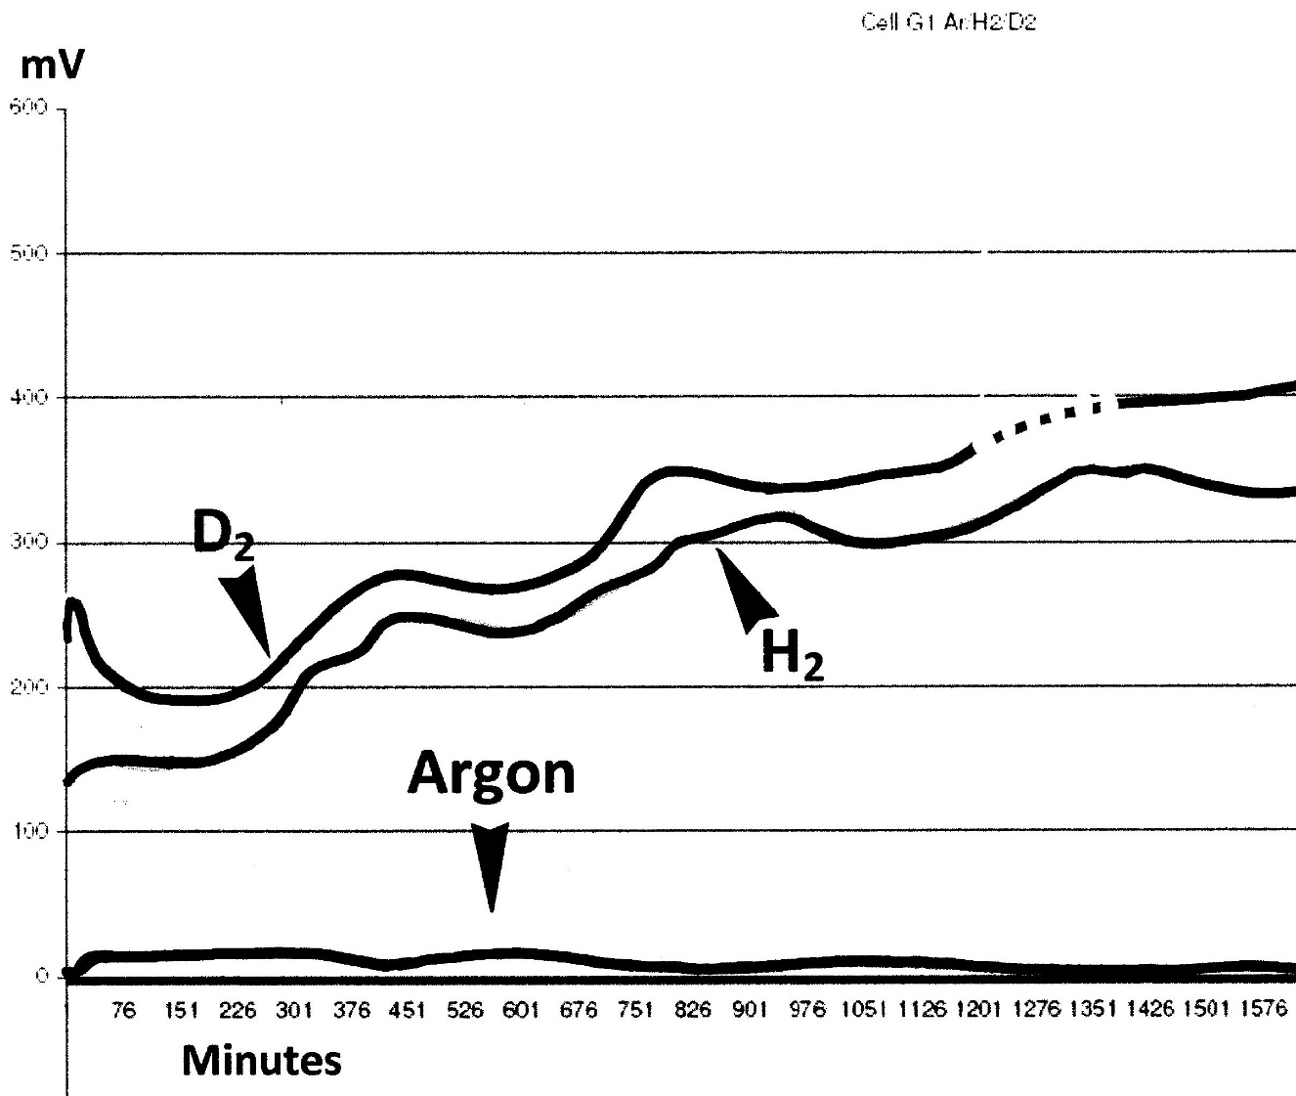
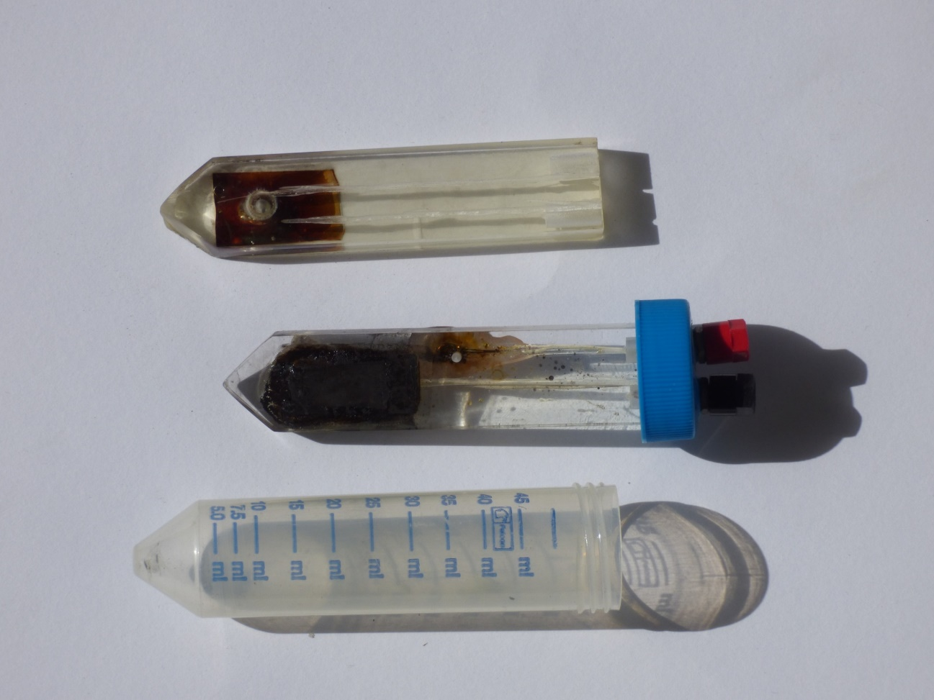
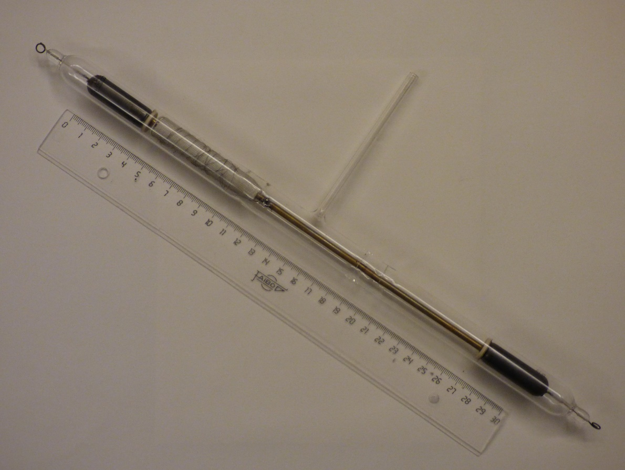
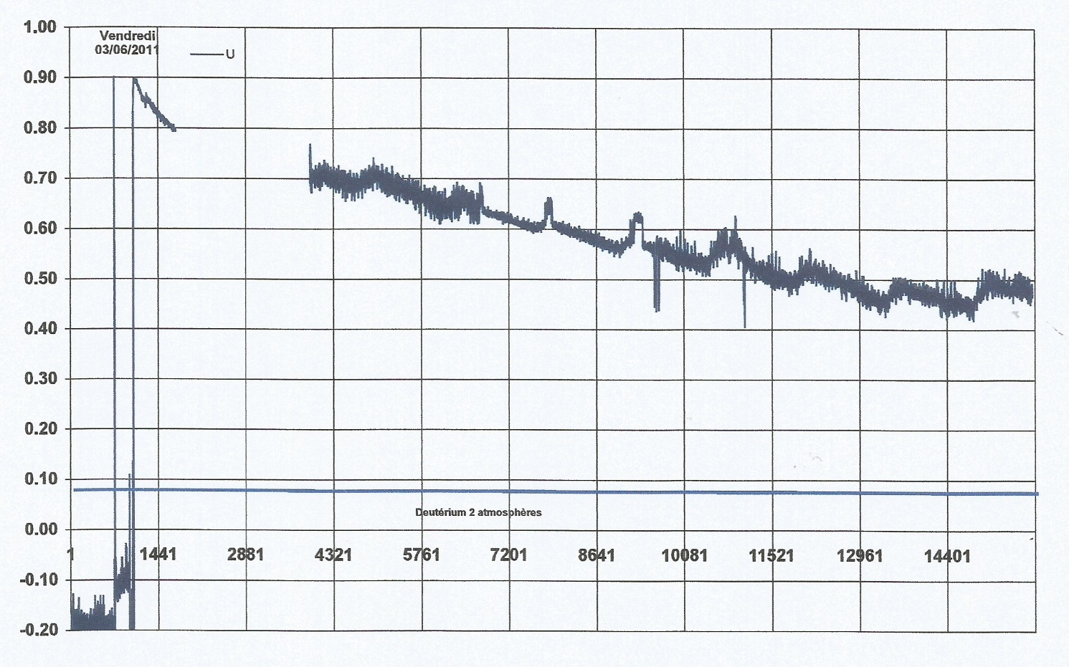
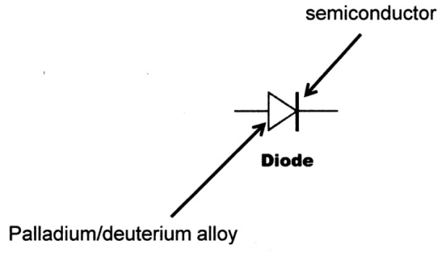
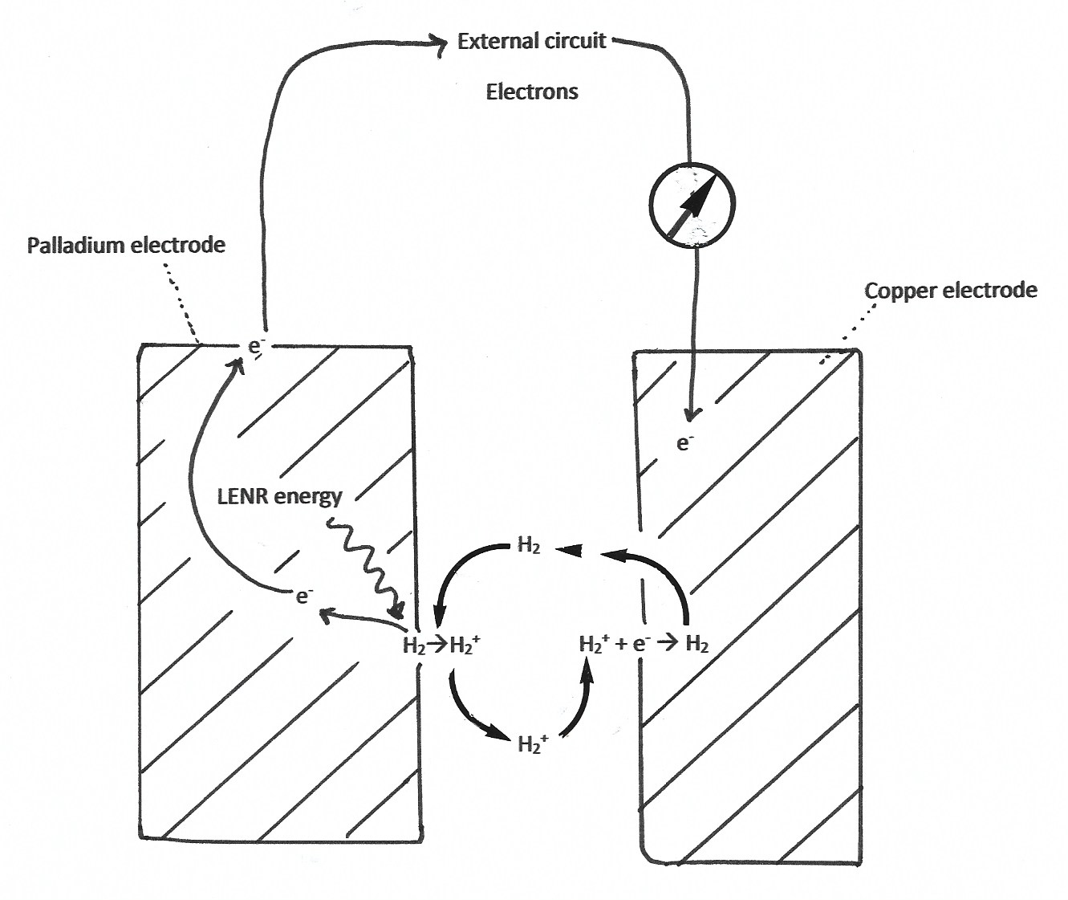
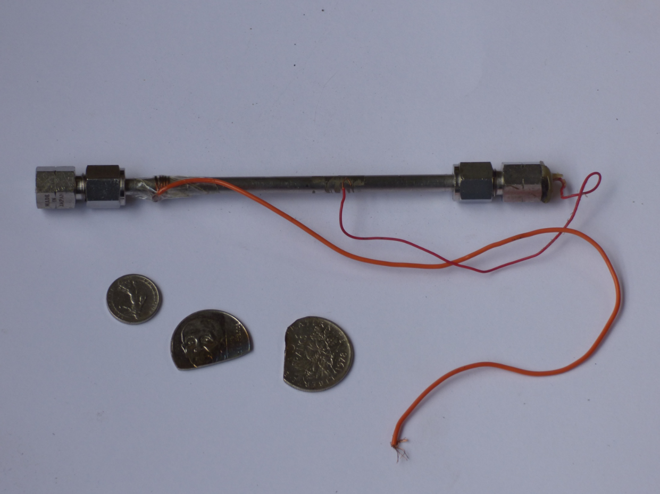
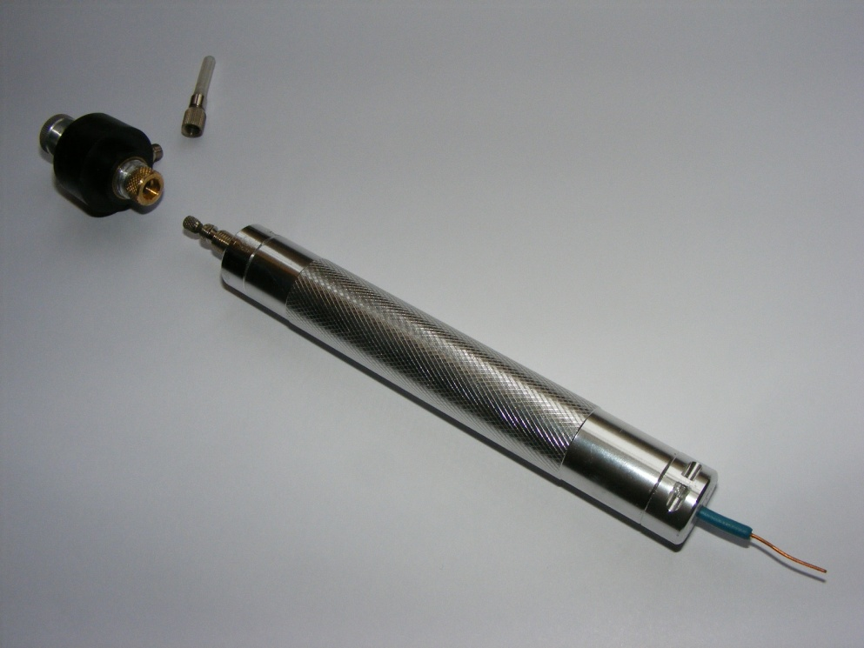
Rules of tiling for
this quasicrystalline
planar pattern.
Rules of tiling for
this quasicrystalline
planar pattern.
Rules of tiling for
this quasicrystalline
planar pattern.
DIRECT CONVERSION : REPLICATIONS
Fabrice DAVID
Laboratoire de Recherches Associatives , BP 4, 95131 Franconville cedex France. davidfa95130@orange.fr
23rd International Conference on Condensed Matter Nuclear Science (ICCF-23)
June 9th-11th, 2021 Xiamen University
Abstract
Direct conversion with Fusion diodes
Before being thermalized, the energy of nuclear reactions will arrive in the electron-volts range. An energy of a few electron volts can interact with electrons in a conductor to move them to a higher energy level.
Take the example of a photovoltaic cell (solar cell). Visible light photons have an energy of about 2 eV. When the junction of a photovoltaic cell is struck by visible light, electrons are excited and go into a higher energy state. The separation of electrons and electronic vacancies in the junction area produces an electric current in the outer circuit
In a patent of May 22, 1990 N ° FR2662537A1, I imagined a diode formed by a junction between a palladium film (2) and a semiconductor silicon wafer. (5) By charging the palladium film by electrolysis of heavy water, I hypothesized that the energy emitted by low-energy nuclear reactions should excite the electrons at the junction (3), and that we should observe an electric power.
The electric field is very important at the junction zone in a diode. For example, in a 1 micrometer thick junction, with a voltage of 1 volt, there is an electric field of one megavolt per meter. This electric field could help compress the deuterium nuclei in the junction area, in order to generate what Dr. Edmund Storms called a “Nuclear Active Environment” (NAE) [2]
With John Giles, a very dynamic petroleum engineer, we founded the start-up "Deuo Dynamics" intended to develop fusion diode technology. We have manufactured several successive models of diodes.
FUSION DIODE MARK I
The first experiments with palladium deposited by electrolysis of a solution of palladium in aqua regia did not result in the observation of self-polarization.
FUSION DIODE MARK II
We prepared another model of fusion diode, based on the patent FR2729249A1 entitled "Process for preparing tritiated waste for treatment and treatment device" from January 11, 1995. This model consists of a very resistant stainless-steel tube internally lined with a plastic tube. The active medium consists is a gradient of silicon powder and nickel powder.
Deuterium under pressure is produced by the reaction between a 20 mm long sodium cylinder placed on one side of the powder and a few drops of heavy water placed on the silicon side before tightening the tube caps. The diode is obviously placed in a steel shatterproof container. We observe a self-polarization of 0.5 volts, which cannot be measured for very long because the internal pressure causes the insulating plastic to flow. This very poorly designed diode is only mentioned for the record.
FUSION DIODE MARK III
We have manufactured several models of fusion diodes, including models in glass tubes contained in copper containers. The powders cannot be compressed and the "Branly Effect" produces a very large irregularity in tension. the Branly effect produces an electric "noise" due to the reorganization of the grains of powder which expand under the influence of electric current. Nevertheless, the Mark 3 models proved to us that the concept of the Fusion Diode was operational.
Together with John Giles, we made Fusion Diodes that consist of a gradient of powdered palladium and silicon, the powders being press-packed into a heavy-duty nylon tube.
As soon as the deuterium is introduced, we observe the appearance of a spontaneous voltage which reaches up to 0.8 volts per diode. A hydrogen-filled diode gives a lower voltage and an argon-filled diode gives a negligible voltage.
The polarization that occurs in the presence of hydrogen is caused by the small amount of deuterium present in hydrogen. The voltage waving is probably due to the fact that our Scottish laboratory is not air-conditioned, and the daily temperature variations are very large there in winter.
Pr. Jean-Paul Bibérian kindly tested this Mark 4 model in his laboratory at the Faculty of Marseilles. Here is the recording obtained over several days, the diode being isolated in a sealed metal container filled with pressurized hydrogen, to minimize leaks. We first observe a voltage drop, but it seems to stabilize asymptotically after some days.
FUSION DIODE MARK V
A machined aluminum container is used, internally insulated by a PVC tube. A ground valve makes it possible to pressurize the powder gradient. The powder is compacted with a hydraulic press. After pressurization with deuterium, a voltage of approximately 500 mV is observed.
II. THE ENTENMANN EFFECT
We passed the baton on to a dynamic American team, lead by Charles Entenmann. Charles Entenmann is a member of the Entenmann family whose name is familiar to Americans. Entenmann’s bakeries produce very good Entenmann’s breads, cakes and donuts in many locations.
Charles Entenmann funded numerous philanthropic foundations. These include in particular the University Hospital of Sarasota, (Florida) and the Roskamp Institute dedicated to research on Alzheimer's disease. Charles Entenmann took an early interest in Cold Fusion and supported the research of Alf Thomson and several researchers and journalists in the field of Nuclear Reactions in Condensed Matter. Charles Entenmann has developed with Alf Thomson a new type of revolutionary hemostatic and bacteriostatic dressing: “BIOSEAL”. He founded the BIOLIFE company, and a factory was built in Sarasota. He also founded the BIOSEARCH company for innovative multidisciplinary research. Charles Entenmann attended the ICCF 18 meeting in Washington and immediately saw the potential of fusion diode technology. He decided to set up a laboratory and assemble a team in the premises of the company Biosearch in Sarasota.
The team of the company Biosearch did an extremely important job: more than 1500 fusion diodes tested, with many pairs of metals and semiconductors.
The energy released was measured by both voltametry and calorimetry. Many calorimeters have been built by the team of Dr. Rebecca Kitko and Kelly Keene. Radiation measurements were carried out by many methods, including a fog chamber to visualize the trace of the energetic particles emitted. They reproducibly observed the appearance of a spontaneous voltage and observed electric currents produced by fusion diodes. They recorded sustained voltages for more than 15 months. They managed (briefly) to light a low-powered red light emitting diode. Patents were filled. [3]
But Charles Entenman’s team discovered something extraordinary: even when replacing the semiconductor with a perfectly insulating material in the diode, such as paper or asbestos we still observe the appearance of spontaneous tension. This tension persists for several months.
I admit that first, I did not believe in this effect, because I feared an experimental error,
but I now admit my mistake: I was wrong.
However, this effect really does exist, I checked it recently and this effect deserves to be called the "ENTENMANN EFFECT"
The team assembled by Charles Entenmann, using a fog chamber, demonstrated the emission of highly energetic charged particles by fusion diodes. Note that the particles manage to pass through the plastic or metal wall of the diode. Their energy is therefore greater than the mega electron volt. (For the record, the beta particles emitted by phosphorus 32 have a maximum energy of 1.7 MeV, and they can pass through about 0.8 mm of plastic. Protons and helium nuclei are even less penetrating.) Obviously, the ionization that causes fusion diodes to polarize is not due to these rare charged particles, otherwise it would require a much larger flux. We will not discuss these particles in this poster.
The technology of "fusion diodes" was proposed several years ago to convert the energy of nuclear reactions taking place in condensed matter into electricity.
For 4 years, positive results have been obtained by several teams and patents filed.
The author summarize some recent advances.
Summary
THE FUSION DIODES
THE ENTENMANN EFFECT
INOVL, INC. RESULTS
REPLICATION OF INOVL, INC. RESULTS
V. DISCUSSION
III. INOVL INC. TEAM RESULTS
Using a different experimental set-up, the self-polarization of fusion diodes was also observed by Frank Gordon's team in San Diego. They dramatically improved the technique. Frank Gordon is one of the foremost researchers in the field of LENR. He has long managed research programs at a high level in the laboratories of the NAVY, in particular in the famous establishment "SPAWAR" (Space and Naval Warfare Systems Command) Only a small part of the results obtained in the laboratories of the NAVY have been published. Frank Gordon founded a company named INOVL, INC. To continue his research and above all to obtain energy production systems that can be used industrially. The results obtained by his team are quite remarkable: they use a device consisting of a metal electrode coated with nanocrystalline palladium by the patented method of "co-deposition". "Co-deposition" consists of producing a layer of palladium highly charged with hydrogen or deuterium by electrolysis of a suitable solution of palladium salt, with a soluble palladium anode.
Placed in an atmosphere of hydrogen, a copper electrode coated with palladium by co-deposition causes a voltage to appear in the presence of a metal counter electrode. [4]
REPLICATION OF INOVL, INC. RESULTS
I built out 3 experimental devices: 1) A glass diode containing a polished steel electrode in front of a spiral of palladium wire 0.1 mm in diameter (Sigma) said electrode being coated with nanocrystalline palladium by co-deposition. The two electrodes are separated by a porous sleeve of glass cloth. The tube is filled with hydrogen at atmospheric pressure and can be flame sealed. The main problem encountered is that the wire becomes extremely brittle after an overnight hydrogen charge.
RESULTS: After filling with hydrogen, a very unstable SPONTANEOUS
voltage of about 10 millivolts is measured.
2) A glass and resin cell containing a metal electrode consisting of a
steel cloth disc and an electrode consisting of a 0.2 mm thick copper
foil disc coated with nanocrystalline palladium by co-deposition.
(Sigma, deposit under 2 volts overnight) The electrode is covered with
a palladium black deposit.
RESULTS: After filling with hydrogen, a very unstable SPONTANEOUS
voltage is measured again of around 50 millivolts.
3) A glass and resin "control" twin cells containing a metal electrode consisting of a bronze cloth disc and an electrode consisting of a lead covered with spongy lead 4 mm thick. This electrode is "formed" for three weeks by the Planté method by charge-discharge cycles in sulfuric acid at 14 ° Baumé. The cycles are ¼ hour; ¼ hour, then ¼ hour discharge, ½ hour charge, then ¼ hour; ¾ of an hour, then fully charged for several hours
RESULTS: After filling with hydrogen, no voltage is measured, EXCEPT WHEN PLACED UNDER DIRECT SUNLIGHT.
V. DISCUSSION
THE FUSION DIODES
The results of Fleischmann and Pons were based on calorimetry and the detection of radiation emitted by low-energy nuclear reactions taking place in palladium. (Low Energy Nuclear Reactions or L.E.N.R.) [1] By their very nature, low energy nuclear reactions emit little radiation.
Calorimetry techniques applied to the study of LENRs are often masterpieces of experimental science, and their results are indisputable. Unfortunately, the relative theoretical and practical complexity of well-designed calorimetry measurements are the cause that the results obtained by this method have not yet succeeded in convincing the majority of the scientific community.
On the other hand, LENRs produce heat at low temperatures, and this form of energy is not very useful industrially.
This is what led me to search, as early as 1991, for an alternative method. I have patented the concept of "Fusion Diode".
What is a "Fusion Diode"?
A fusion diode is a hydride or deuteride material in close contact with a semiconductor.
.
Undoubtly, we have ionization of the hydrogen inside the cells. It is unlikely that it is energetic particles that produce this ionization, otherwise it would require considerable radioactivity. Palladium cathodes can release atomic hydrogen atoms. [5] But these atomic hydrogen atoms, while very reactive, are not charged. Also, this is a chemical reaction, it does not last long. Frank Gordon observes voltage and current for several weeks. What ions can we see in hydrogen? To answer this question, I will quote an article presented to Louis De Broglie in 1962 in the French PNAS [6] In our experiments, I suggest that the energy of ionization of the hydrogen atoms and molecules is given by the down-conversion of the LERN energy. There is a “nucleochemical” ionization effect of the adsorbed hydrogen molecules, which give H⁺, H₂⁺ and H₂⁺ ions, which diffuse in the gas phase and will neutralize on the counter electrode and return to the palladium and the cycle continues.
It is this energy which generate a voltage in the diodes.
This reaction would provide a convenient way to convert the energy released by LENRs into electricity.
It will be important to reproduce all these results with perfectly sealed glass diodes, and to record the produced power during months, in order to prove the nuclear origin of the energy.
REFERENCES
[1] M. Fleischman and S. Pons. J. Electroanal. Chem., (261):301, 1989
[2] Storms, E. What Conditions Are Required To Initiate The Lenr Effect? in Tenth International Conference on Cold Fusion. 2003. Cambridge, MA
[3] PCT WO 2016/178723 Al 27 January 2016 Kelly KEENE, Talmadge Kelly Rebecca VAN ORDEN, Charles ENTENMANN and David COTTRELL
[4] Lattice Energy Converter, Gordon F.E., Whitehouse H.J., RNBE 2020 Paris, November 2020.
[5] F. David and J. Giles Possible Production of Atomic Deuterium By Palladium Cathode Materials Research Innovations 2008, VOL 12, NO 4 172
[6] Etude au spectromètre de masse de l'hydrogène dégagé par le palladium, 8 octobre 1962, C.R. Acad. Sci. Pp. 1724-1756
Order online at https://www.postersession.com/order/

